Slide 1



ACE-THE-CASE
PRESENTATION
~Team Priyal
180Degrees
Consulting

Slide 2







Our Best Team
Priyal Goenka
Anish Gudle
Revti Raman
Team Lead
Design Head
Content Head
Piyush Vijayvergiya
Vedant Jawale
Market Analyst
Business Analyst

Slide 3


PROBLEM STATEMENT
Ace The Case 2.0
Case study :
BharatMart is #1 Indian Discount Retailer. They have a network of 500 stores across India and hold a prominent position in both market share and profitability. The second-largest discount retailer in India, GangaBazaar, operates 300 stores. IndoMart, a US-based discount retailer with 4000 stores in the US, is contemplating the acquisition of GangaBazaar. Analyze how this acquisition could pose a potential threat to BharatMart. Analyze and suggest the strategies BharatMart might adopt to face potential losses, challenges, and the best way forward in this scenario.

Slide 4

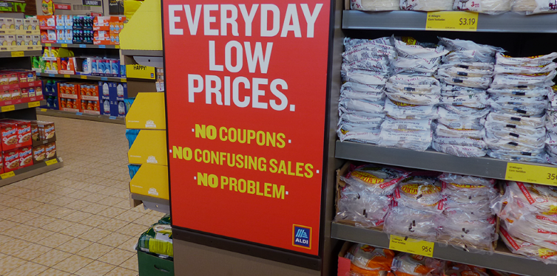

Discount Stores
A discount store is a retail store that sells products at lower prices than traditional retail outlets.
1.More for Less
2.Target Audience
3.General Stratergies
4.Expenditure

Slide 5

What is BharatMart?
BharatMart is #1 Indian Discount Retailer. They have a network of 500 stores across India and hold a prominent position in both market share and profitability.
Business Model
Range of Products
1.Operations
2.Customer-centric
approach
3.Strong financial performanc
4Store operations
Grocery
Household Supplies
Apparel and Footwear
Electronics and Appliances
Home Decor and Furniture

Slide 6




INDOMART ENTRY
01
Competition Increase
For BharatMart
02
FDI Policies
03
Hurdles For IndoMart

Slide 7






PORTER’S 5 FORCES
1. THREAT OF NEW ENTRANTS:
2. BARGAINING POWER OF SUPPLIERS
3. BARGAINING POWER OF BUYERS
4. THREAT OF SUBSTITUTES
5.COMPETETIVE RIVALRY
Low
After IndoMart’s Entry:
1)Increase competitive pressure
2)Could attract further foreign players
Moderate
After IndoMart’s Entry:
1)Combined Buying power increase
2)Supplier Dependance Increase
High
After IndoMart’s Entry:
1)Competitive Pricing
2)Wider choices for customer to choose from
Moderate
After IndoMart’s Entry:
1)Not significant unless they launch new product
2)Effect on online grocery growth
High
After IndoMart’s Acquisition:
1)Intense in certain locations
2)Need of differentiation for BharatMart

Slide 8



03.
02.
04.
Brand Recognition and Marketing Power
Supply Chain Optimization and Efficiency
Innovation and Technology
01.
05.
Talent acquisition and Management
Global Sourcing and Economies of Scale
Competitive
Analysis

Slide 9

The Regional Advantages of GangaBazaar
01
Strong Regional Presence
Local Supplier Networks and Relationships
02
03
Potential Knowledge Transfer and Employee Loyalty
Regional Distribution and Logistics Network
04

Slide 10

GUESSTIMATE
Gross profit per store:
Revenue - COGS = 15.25% of revenue
Profitability Impact on:
1)Rented Stores: Total net profit for 150 rented stores = 1431Cr
2)Owned Stores: Total net profit for 350 owned stores- 7350 Cr.
Total Profit(Rented+Owned)=87.81 billion
Total Revenue of BharatMart=1000Billion
Net Profit= (87.81/1000)*100 = 8.781% of revenue
Cost Categories: Allocate percentages of revenue to major cost components:
Rent:6.48% (depending on store size and location)
Salaries: 2.25% (considering employee benefits and varying store sizes)
Inventory: 84% (accounting for product mix and holding costs)
Marketing & Promotions: 1.75% (variable depending on current promotional strategies)
Other Operating Expenses: 0.75% (encompassing utilities, maintenance, and operational costs)

Slide 11
GUESSTIMATE
2)Impact on Profit
For calculation of Profitability dip , the net profit percentage is common for all scenarios i.e 8.781% of revenue.
Scenario 1: For 5% market share dip
8.781% of 50 billion = ₹ 4.39 billion dip in net profit
Scenario 2: For 10% market share dip
8.781% of 100 billion revenue ₹8.78 billion dip in net profit.
Scenario 3: For 15% market share dip
8.781% of 150 billion revenue : ₹13.17 billion dip in net profit.
Market Share Loss Senarios
1) Impact on Revenue:
If for Bharatmart’s market share dip is by
Scenario 1: 5% market share loss (estimated at ₹50 billion revenue loss based on assumed total revenue of ₹1000 billion).
Scenario 2: 10% market share loss (estimated at ₹100 billion revenue loss).
Scenario 3: 15% market share loss (estimated at ₹150 billion revenue loss).

Slide 12





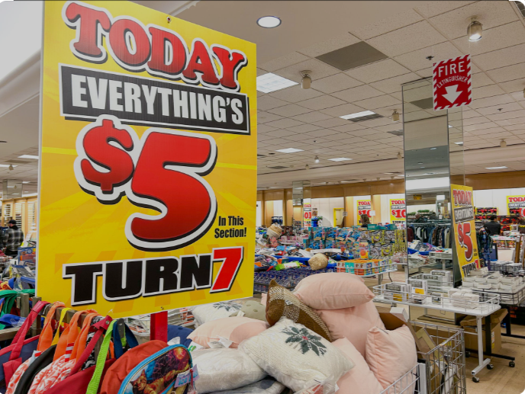
Strengths of BharatMart
01 Market Leadership:
BharatMart holds the top position among Indian discount retailers, with a network of 500 stores.
02 Profitability:
The case study mentions that BharatMart is not only the market leader in terms of the number of stores but also in profitability.
03 Extensive Network:
With 500 stores across India, BharatMart has a wide and well-established retail network, providing extensive coverage and accessibility to customers.
04 Local Understanding:
Being an Indian retailer, BharatMart likely has a deep understanding of local consumer preferences,and market dynamics, which can be a significant advantage in the retail sector.

Slide 13

BharatMart Future Strategy
1. Localized Offerings:
2.Personalized Service
Go hyperlocal
Partner with local artisans and small businesses
Curate regional product baskets
Invest in AI and data analytics
Implement loyalty programs
Provide personalized customer support
3.Community Engagement:
4. Sustainable Sourcing:
Build local partnerships
Support local causes
Create online communities
Partner with eco-friendly suppliers
Reduce carbon footprint
Promote fair trade practices

Slide 14

Operational Optimization Roadmap for BharatMart
1.Inventory Management System
4.Supply Chain Management
2.Internal Control System (ICS)
5.Competing with IndoMart's Scale
3.Process Streamlining

Slide 15
1) Targeted Marketing Campaigns:
Hyperlocal content
Personalized promotions
Community-driven marketing
Mobile-first approach
Customer Engagement Initiatives for BharatMart
2) Loyalty Programs:
Tiered loyalty program
Referral program
Community events and partnerships
Gamification elements.

Slide 16

BUSINESS EXPANSION RECOMMENDATIONS FOR BHARATMART
SATURATED MARKET - TIER 1 CITIES: DELIVERY SERVICES
UNSATURATED MARKET: OWNERSHIP OF STORES

Slide 17
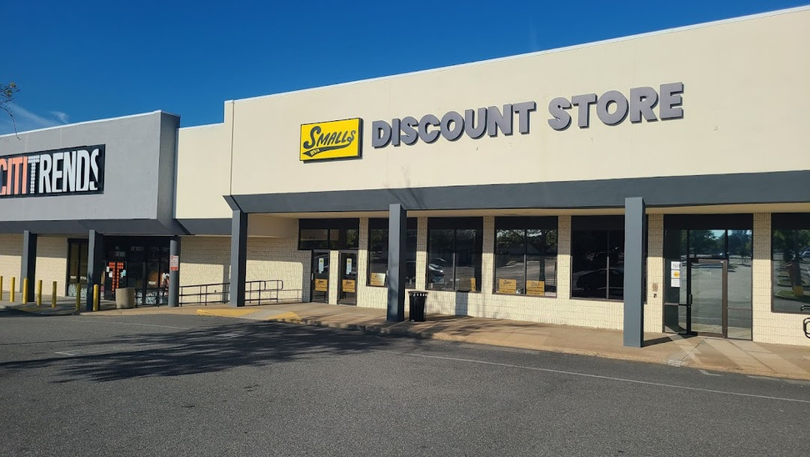
CONCLUSION
BharatMart faces a significant challenge with IndoMart's entry into the Indian market through the potential acquisition of GangaBazaar. The threat lies in intensified competition, potential loss of market share, and the risk of facing a more technologically advanced and globally experienced competitor. The analysis emphasizes the need for BharatMart to focus on cost efficiency, customer differentiation, and strategic partnerships to maintain its leadership in the Indian discount retail sector.
To overcome these challenges, BharatMart should adopt a multi-faceted strategy. The company should emphasize localized offerings, personalization, community engagement, and sustainable sourcing to strengthen its brand differentiation and build strong connections with Indian consumers.

Slide 18

Thank You
For Watching
Thank you to all our valued viewers for taking the time to engage with our presentation on BharatMart's case study. Your attention and interest are truly appreciated. If you have any further questions or if there's anything you'd like to discuss, feel free to reach out.

